Slide 1
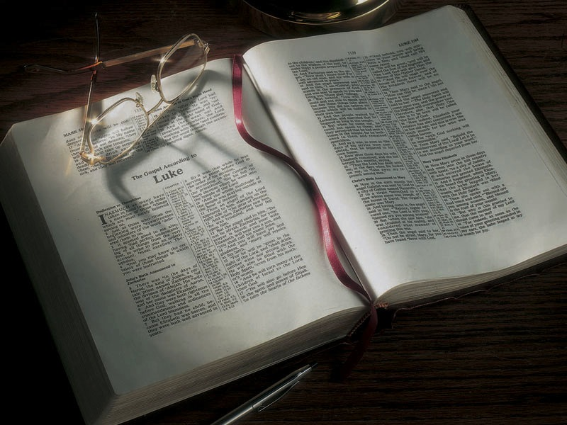

Slide 2
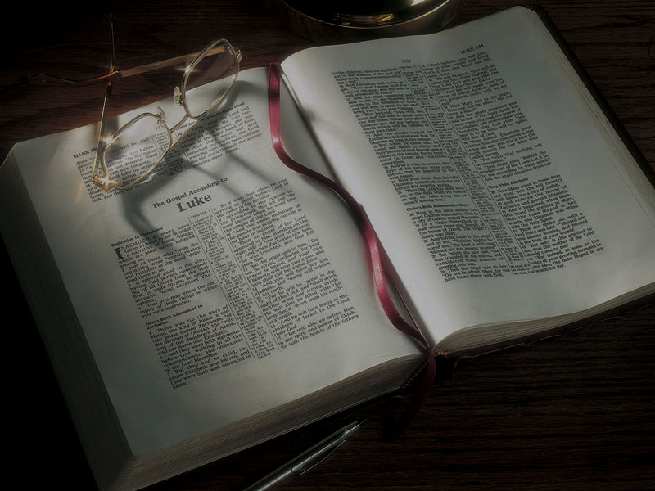
The Gospels
The Temptation in the Wilderness

Slide 3
Matthew 4:1-11
1 Then Jesus was led up by the Spirit into the wilderness to be tempted by the devil.
2 And when He had fasted forty days and forty nights, afterward He was hungry.
3 Now when the tempter came to Him, he said, “If You are the Son of God, command that these stones become bread.”
4 But He answered and said, “It is written, ‘Man shall not live by bread alone, but by every word that proceeds from the mouth of God.’”
5 Then the devil took Him up into the holy city, set Him on the pinnacle of the temple,
6 and said to Him, “If You are the Son of God, throw Yourself down. For it is written: ‘He shall give His angels charge over you,’ and, ‘In their hands they shall bear you up, Lest you dash your foot against a stone.’”
7 Jesus said to him, “It is written again, ‘You shall not tempt the LORD your God.’”
8 Again, the devil took Him up on an exceedingly high mountain, and showed Him all the kingdoms of the world and their glory.
9 And he said to Him, “All these things I will give You if You will fall down and worship me.”
10 Then Jesus said to him, “Away with you, Satan! For it is written, ‘You shall worship the LORD your God, and Him only you shall serve.’”
11 Then the devil left Him, and behold, angels came and ministered to Him.

Slide 4
Deuteronomy 8:3
3 So He humbled you, allowed you to hunger, and fed you with manna which you did not know nor did your fathers know, that He might make you know that man shall not live by bread alone; but man lives by every word that proceeds from the mouth of the LORD.

Slide 5
Psalm 91:11-12
11 For He shall give His angels charge over you, to keep you in all your ways.
12 In their hands they shall bear you up, lest you dash your foot against a stone.

Slide 6
Psalm 91:11-12
11 For He shall give His angels charge over you, to keep you in all your ways.
12 In their hands they shall bear you up, lest you dash your foot against a stone.

Slide 7
Deuteronomy 6:16
16 You shall not tempt the LORD your God . . .

Slide 8
Deuteronomy 6:13
13 You shall fear the LORD your God and serve Him . . .

Slide 9
Matthew 16:26
26 For what profit is it to a man if he gains the whole world, and loses his own soul? Or what will a man give in exchange for his soul?

Slide 10
1 John 2:15-17
15 Do not love the world or the things in the world. If anyone loves the world, the love of the Father is not in him.
16 For all that is in the world—the lust of the flesh, the lust of the eyes, and the pride of life—is not of the Father but is of the world.
17 And the world is passing away, and the lust of it; but he who does the will of God abides forever.

Slide 11
James 4:7
7 Therefore submit to God. Resist the devil and he will flee from you.

Slide 12
Luke 4:1-13
Then Jesus, being filled with the Holy Spirit, returned from the Jordan and was led by the Spirit into the wilderness,
2 being tempted for forty days by the devil. And in those days He ate nothing, and afterward, when they had ended, He was hungry.
3 And the devil said to Him, “If You are the Son of God, command this stone to become bread.”
4 But Jesus answered him, saying, “It is written, ‘Man shall not live by bread alone, but by every word of God.’”
5 Then the devil, taking Him up on a high mountain, showed Him all the kingdoms of the world in a moment of time.
6 And the devil said to Him, “All this authority I will give You, and their glory; for this has been delivered to me, and I give it to whomever I wish.
7 “Therefore, if You will worship before me, all will be Yours.”
8 And Jesus answered and said to him, “Get behind Me, Satan! For it is written, ‘You shall worship the LORD your God, and Him only you shall serve.’”
9 Then he brought Him to Jerusalem, set Him on the pinnacle of the temple, and said to Him, “If You are the Son of God, throw Yourself down from here.
10 “For it is written: ‘He shall give His angels charge over you, To keep you,’
11 “and, ‘In their hands they shall bear you up, Lest you dash your foot against a stone.’”
12 And Jesus answered and said to him, “It has been said, ‘You shall not tempt the LORD your God.’”
13 Now when the devil had ended every temptation, he departed from Him until an opportune time.

Slide 13
Mark 1:12-13
12 Immediately the Spirit drove Him into the wilderness.
13 And He was there in the wilderness forty days, tempted by Satan, and was with the wild beasts; and the angels ministered to Him.

Slide 14
Deuteronomy 9:9-11
9 “When I went up into the mountain to receive the tablets of stone, the tablets of the covenant which the LORD made with you, then I stayed on the mountain forty days and forty nights. I neither ate bread nor drank water.
10 “Then the LORD delivered to me two tablets of stone written with the finger of God, and on them were all the words which the LORD had spoken to you on the mountain from the midst of the fire in the day of the assembly.
11 “And it came to pass, at the end of forty days and forty nights, that the LORD gave me the two tablets of stone, the tablets of the covenant.

Slide 15
1 Kings 19:1-8
1 And Ahab told Jezebel all that Elijah had done, also how he had executed all the prophets with the sword.
2 Then Jezebel sent a messenger to Elijah, saying, “So let the gods do to me, and more also, if I do not make your life as the life of one of them by tomorrow about this time.”
3 And when he saw that, he arose and ran for his life, and went to Beersheba, which belongs to Judah, and left his servant there.
4 But he himself went a day’s journey into the wilderness, and came and sat down under a broom tree. And he prayed that he might die, and said, “It is enough! Now, LORD, take my life, for I am no better than my fathers!”
5 Then as he lay and slept under a broom tree, suddenly an angel touched him, and said to him, “Arise and eat.”
6 Then he looked, and there by his head was a cake baked on coals, and a jar of water. So he ate and drank, and lay down again.
7 And the angel of the LORD came back the second time, and touched him, and said, “Arise and eat, because the journey is too great for you.”
8 So he arose, and ate and drank; and he went in the strength of that food forty days and forty nights as far as Horeb, the mountain of God.

Slide 16
Deuteronomy 8:2-3
2 “And you shall remember that the LORD your God led you all the way these forty years in the wilderness, to humble you and test you, to know what was in your heart, whether you would keep His commandments or not.
3 “So He humbled you, allowed you to hunger, and fed you with manna which you did not know nor did your fathers know, that He might make you know that man shall not live by bread alone; but man lives by every word that proceeds from the mouth of the LORD.

Slide 17
Hebrews 5:8
8 though He was a Son, yet He learned obedience by the things which He suffered.

Slide 18
1 Corinthians 10:13
13 No temptation has overtaken you except such as is common to man; but God is faithful, who will not allow you to be tempted beyond what you are able, but with the temptation will also make the way of escape, that you may be able to bear it.

Slide 19
James 1:13-15
13 Let no one say when he is tempted, “I am tempted by God”; for God cannot be tempted by evil, nor does He Himself tempt anyone.
14 But each one is tempted when he is drawn away by his own desires and enticed.
15 Then, when desire has conceived, it gives birth to sin; and sin, when it is full-grown, brings forth death.

Slide 20
1 John 2:16
16 For all that is in the world—the lust of the flesh, the lust of the eyes, and the pride of life— is not of the Father but is of the world.

Slide 21
Hebrews 4:15-16
15 For we do not have a High Priest who cannot sympathize with our weaknesses, but was in all points tempted as we are, yet without sin.
16 Let us therefore come boldly to the throne of grace, that we may obtain mercy and find grace to help in time of need.

Slide 22
Wilderness Images Connected With Jesus Christ
Prophet like Moses
High Priest
Light of the world (menorah, pillar of fire)
Bronze serpent
Rock from which water flowed
Passover lamb
Sacrificial system
Manna

Slide 23
Prophet like Moses:
Deuteronomy 18:17-18
17 And the LORD said to me: …
18 “I will raise up for them a Prophet like you from among their brethren, and will put My words in His mouth, and He shall speak to them all that I command Him.”
John 6:14; 7:40
“Truly this is the Prophet.”

Slide 24
High Priest:
Hebrews 4:14
14 Seeing then that we have a great High Priest who has passed through the heavens, Jesus the Son of God, let us hold fast our confession.

Slide 25
Light of the World
John 1:9
9 [Jesus Christ] was the true Light which gives light to every man coming into the world.

Slide 26
Bronze serpent:
John 3:14
14 And as Moses lifted up the serpent in the wilderness, even so must the Son of Man be lifted up.

Slide 27
Rock from which water flowed:
1 Corinthians 10:4
4 For they drank of that spiritual Rock that followed them, and that Rock was Christ.

Slide 28
Passover lamb:
John 1:29
29 The next day John saw Jesus coming toward him, and said, “Behold! The Lamb of God who takes away the sin of the world!

Slide 29
Sacrificial system:
Hebrews 10:11-14
11 And every priest stands ministering daily and offering repeatedly the same sacrifices, which can never take away sins.
12 But this Man, after He had offered one sacrifice for sins forever, sat down at the right hand of God,
13 from that time waiting till His enemies are made His footstool.
14 For by one offering He has perfected forever those who are being sanctified.

Slide 30
Manna:
John 6:31-33
31 “Our fathers ate the manna in the desert; as it is written, ‘He gave them bread from heaven to eat.’”
32 Then Jesus said to them, “Most assuredly, I say to you, Moses did not give you the bread from heaven, but My Father gives you the true bread from heaven.
33 “For the bread of God is He who comes down from heaven and gives life to the world.”

Slide 31
Hebrews 4:15-16
15 For we do not have a High Priest who cannot sympathize with our weaknesses, but was in all points tempted as we are, yet without sin.
16 Let us therefore come boldly to the throne of grace, that we may obtain mercy and find grace to help in time of need.

Slide 32
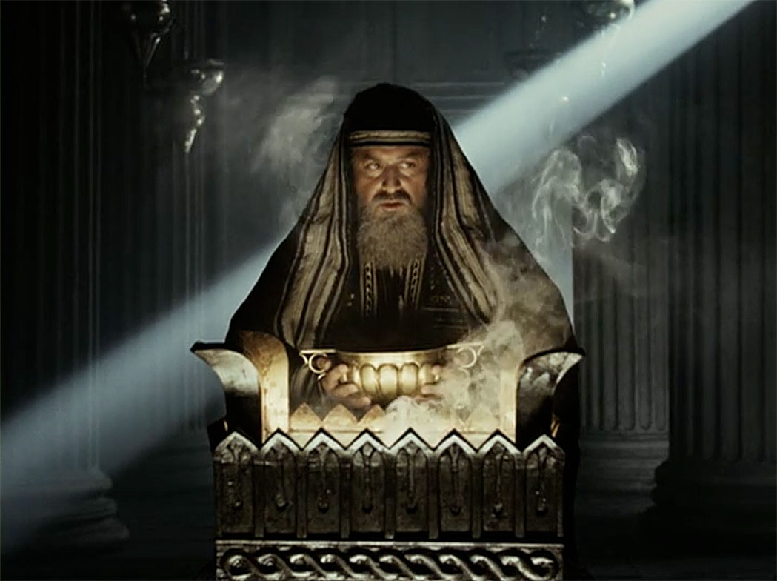

Slide 33
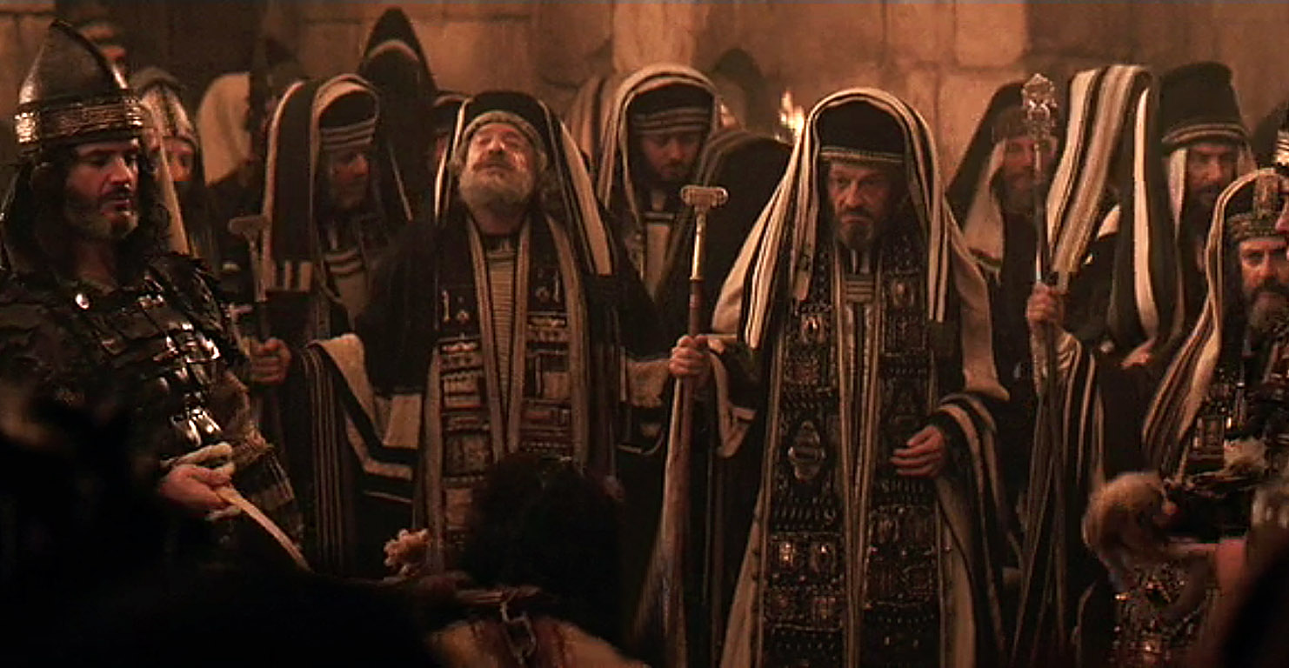

Slide 34
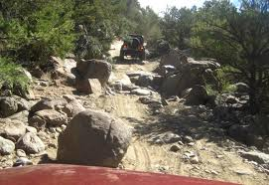

Slide 35
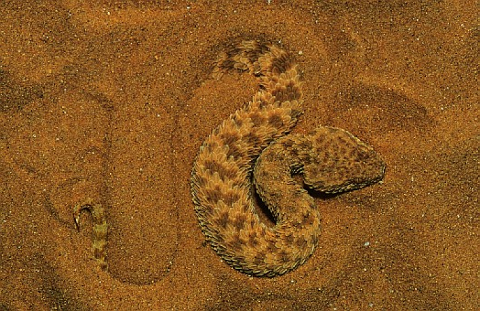

Slide 36
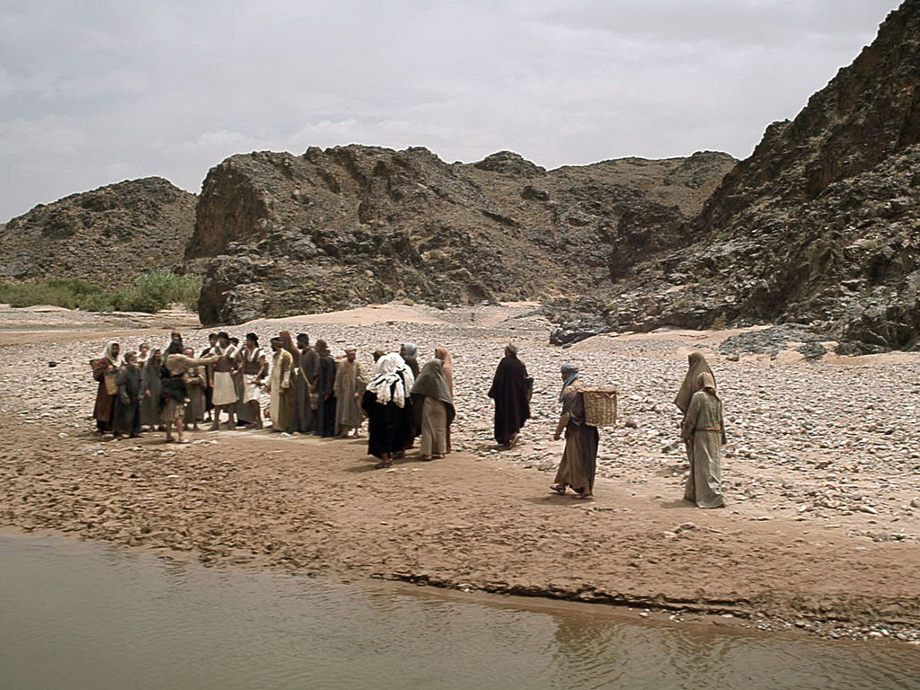

Slide 37
Matthew 3:4
4 And John himself was clothed in camel’s hair, with a leather belt around his waist . . .
Mark 1:6
6 Now John was clothed with camel’s hair and with a leather belt around his waist . . .

Slide 38
2 Kings 1:7-8
7 Then he [King Amaziah] said to them [the messengers], “What kind of man was it who came up to meet you and told you these words?”
8 So they answered him, “A hairy man wearing a leather belt around his waist.” And he said, “It is Elijah the Tishbite.”

Slide 39
2 Kings 1:7-8
7 Then he [King Amaziah] said to them [the messengers], “What kind of man was it who came up to meet you and told you these words?”
8 So they answered him, “A hairy man wearing a leather belt around his waist.” And he said, “It is Elijah the Tishbite.”
“Hairy man” in the original Hebrew is literally
“master/owner/possessor of hair.”

Slide 40
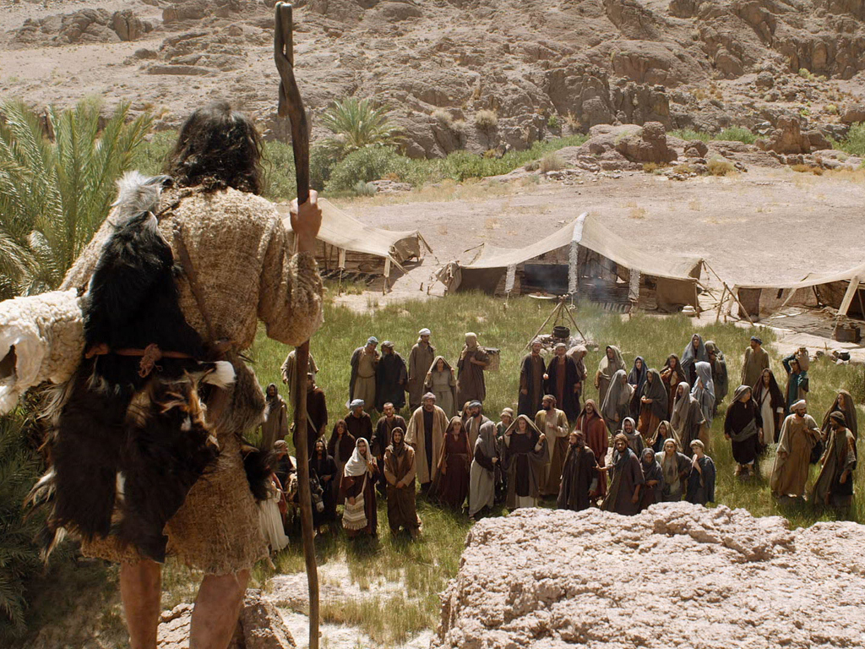

Slide 41
We can’t understand what the words mean for us today if we don’t first understand what they meant to the original audience of that time and culture.

Slide 42
Keep this in mind:
We can’t fully understand what the words mean for us today if we don’t first understand what they meant to the original audience of that time and culture.

Slide 43
Luke 3:15-18
15 Now as the people were in expectation, and all reasoned in their hearts about John, whether he was the Christ or not,
16 John answered, saying to all, “I indeed baptize you with water; but One mightier than I is coming, whose sandal strap I am not worthy to loose. He will baptize you with the Holy Spirit and fire.

Slide 44
Luke 3:15-18
15 Now as the people were in expectation, and all reasoned in their hearts about John, whether he was the Christ or not,
16 John answered, saying to all, “I indeed baptize you with water; but One mightier than I is coming, whose sandal strap I am not worthy to loose. He will baptize you with the Holy Spirit and fire.
“baptize” = baptizo, meaning “immerse” or “submerge.”

Slide 45
Luke 3:15-18
15 Now as the people were in expectation, and all reasoned in their hearts about John, whether he was the Christ or not,
16 John answered, saying to all, “I indeed baptize you with water; but One mightier than I is coming, whose sandal strap I am not worthy to loose. He will baptize you with the Holy Spirit and fire.
“baptize” = baptizo, meaning “immerse” or “submerge.” It’s used of ships sinking, being “baptized” in the sea.

Slide 46
Luke 3:15-18
15 Now as the people were in expectation, and all reasoned in their hearts about John, whether he was the Christ or not,
16 John answered, saying to all, “I indeed baptize you with water; but One mightier than I is coming, whose sandal strap I am not worthy to loose. He will baptize you with the Holy Spirit and fire.
“with” = en, meaning “with,” “in,” “on,” or “by.”

Slide 47
Luke 3:15-18
15 Now as the people were in expectation, and all reasoned in their hearts about John, whether he was the Christ or not,
16 John answered, saying to all, “I indeed baptize you with in water; but One mightier than I is coming, whose sandal strap I am not worthy to loose. He will baptize you with in the Holy Spirit and fire.
“with” = en, meaning “with,” “in,” “on,” or “by.”

Slide 48
Acts 19:1-5
1 And it happened, while Apollos was at Corinth, that Paul, having passed through the upper regions, came to Ephesus. And finding some disciples
2 he said to them, “Did you receive the Holy Spirit when you believed?” So they said to him, “We have not so much as heard whether there is a Holy Spirit.”
3 And he said to them, “Into what then were you baptized?” So they said, “Into John’s baptism.”

Slide 49
Acts 19:1-5
4 Then Paul said, “John indeed baptized with a baptism of repentance, saying to the people that they should believe on Him who would come after him, that is, on Christ Jesus.”
5 When they heard this, they were baptized in the name of the Lord Jesus.

Slide 50
Luke 3:15-18
16 John answered, saying to all, “I indeed baptize you with water; but One mightier than I is coming, whose sandal strap I am not worthy to loose. He will baptize you with the Holy Spirit and fire.
17 “His winnowing fan is in His hand, and He will thoroughly clean out His threshing floor, and gather the wheat into His barn; but the chaff He will burn with unquenchable fire.”
18 And with many other exhortations he preached to the people.

Slide 51
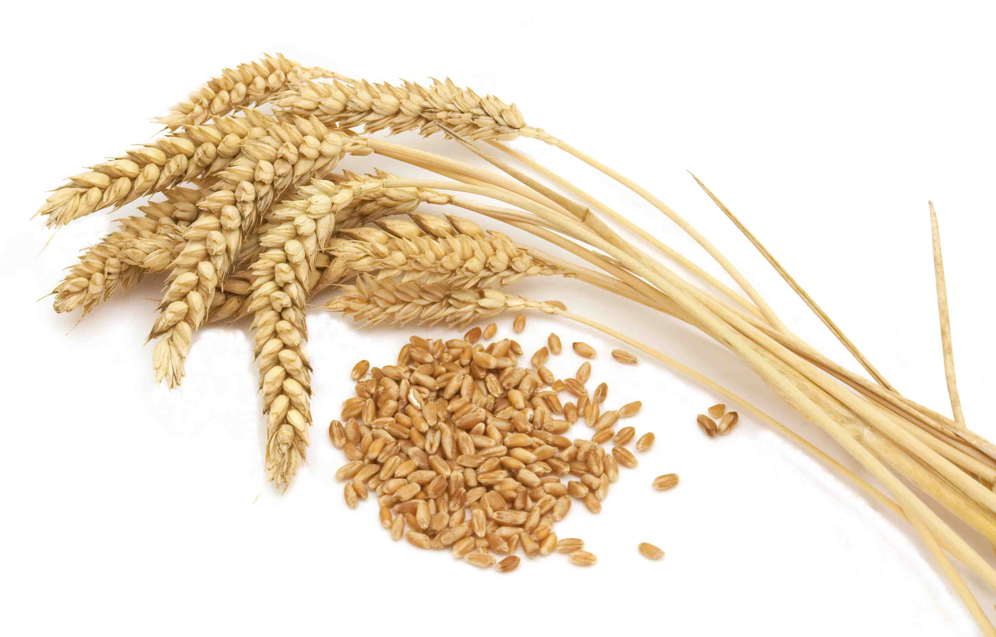

Slide 52
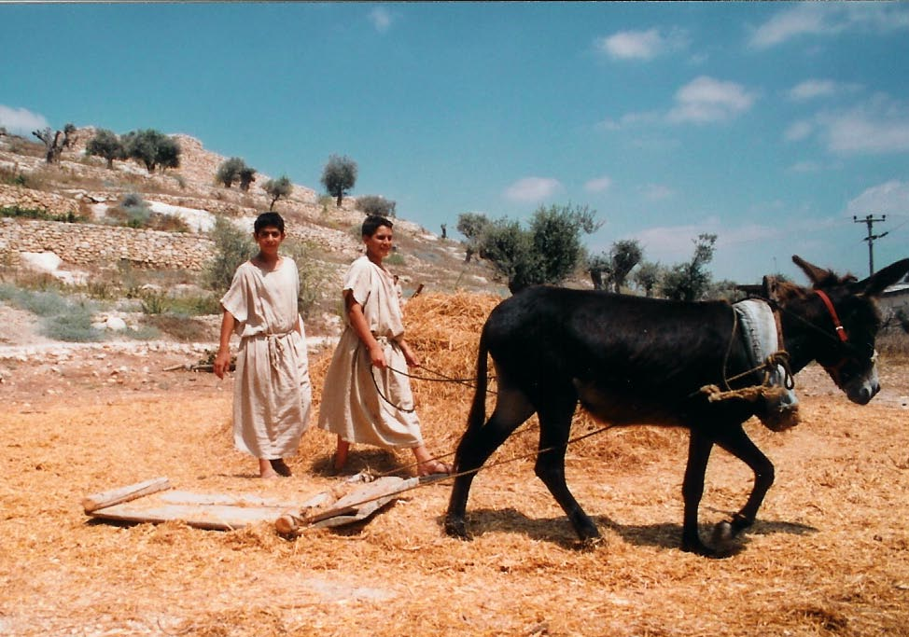

Slide 53
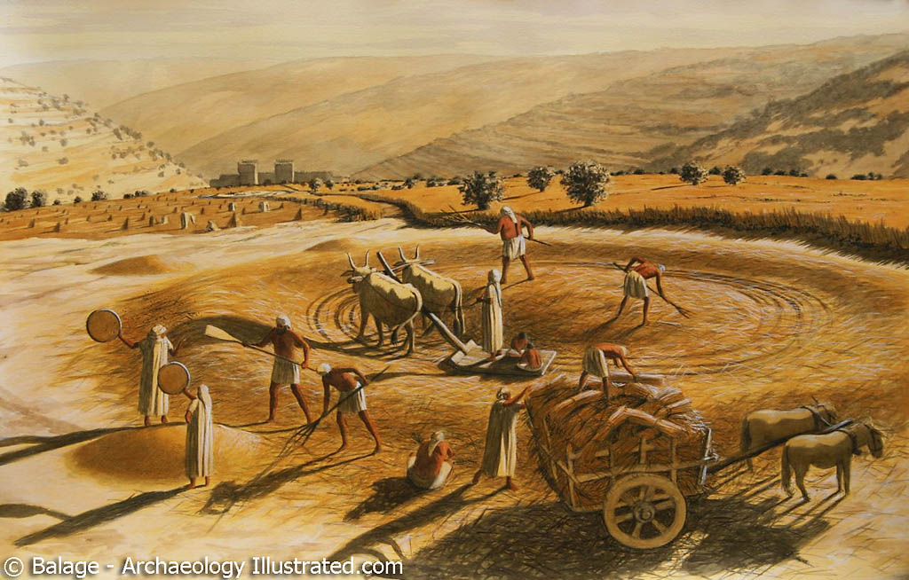

Slide 54
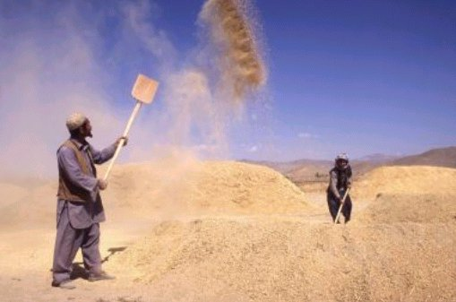

Slide 55
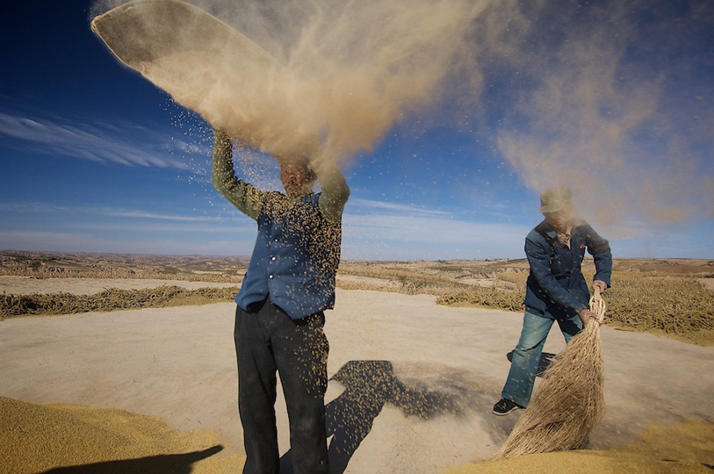

Slide 56
Jeremiah 15:7
7 And I will winnow them with a winnowing fan in the gates of the land; I will bereave them of children; I will destroy My people, since they do not return from their ways.

Slide 57
Jeremiah 15:5-9
5 “For who will have pity on you, O Jerusalem? Or who will bemoan you? Or who will turn aside to ask how you are doing?
6 You have forsaken Me,” says the LORD, “You have gone backward. Therefore I will stretch out My hand against you and destroy you; I am weary of relenting!
7 And I will winnow them with a winnowing fan in the gates of the land; I will bereave them of children; I will destroy My people, since they do not return from their ways.

Slide 58
Jeremiah 15:5-9
8 Their widows will be increased to Me more than the sand of the seas; I will bring against them, against the mother of the young men, a plunderer at noonday; I will cause anguish and terror to fall on them suddenly.
9 “She languishes who has borne seven; she has breathed her last; her sun has gone down while it was yet day; she has been ashamed and con-founded. And the remnant of them I will deliver to the sword before their enemies,” says the LORD.

Slide 59
Matthew 3:4
4 The ungodly . . . are like the chaff which the wind drives away.
Hosea 13:3
3 Therefore they shall be like the morning cloud and like the early dew that passes away, like chaff blown off from a threshing floor and like smoke from a chimney.

Slide 60
Isaiah 5:24
24 Therefore, as the fire devours the stubble, and the flame consumes the chaff, so their root will be as rottenness, and their blossom will ascend like dust; because they have rejected the law of the LORD of hosts, and despised the word of the Holy One of Israel.

Slide 61
Isaiah 66:23-24
23 And it shall come to pass that from one New Moon to another, and from one Sabbath to another, all flesh shall come to worship before Me,” says the LORD.
24 “And they shall go forth and look upon the corpses of the men who have transgressed against Me. For their worm does not die, and their fire is not quenched. They shall be an abhorrence to all flesh.”

Slide 62
Jeremiah 7:20
20 Therefore thus says the Lord GOD: “Behold, My anger and My fury will be poured out on this place—on man and on beast, on the trees of the field and on the fruit of the ground. And it will burn and not be quenched.”

Slide 63
Luke 3:18
18 And with many other exhortations he preached to the people.

Slide 64
Matthew 3:13-15
13 Then Jesus came from Galilee to John at the Jordan to be baptized by him.
14 And John tried to prevent Him, saying, “I need to be baptized by You, and are You coming to me?”
15 But Jesus answered and said to him, “Permit it to be so now, for thus it is fitting for us to fulfill all righteousness.” Then he allowed Him.

Slide 65
Jeremiah 23:5-6
5 “Behold, the days are coming,” says the LORD, “That I will raise to David a Branch of righteousness; a King shall reign and prosper, and execute judgment and righteousness in the earth.
6 In His days Judah will be saved, and Israel will dwell safely; now this is His name by which He will be called: THE LORD OUR RIGHTEOUSNESS.

Slide 66
Jeremiah 23:5-6
5 “Behold, the days are coming,” says the LORD, “That I will raise to David a Branch of righteousness; a King shall reign and prosper, and execute judgment and righteousness in the earth.
6 In His days Judah will be saved, and Israel will dwell safely; now this is His name by which He will be called: THE LORD OUR RIGHTEOUSNESS.
Jesus is referring to this and saying He is Messiah!

Slide 67
Jeremiah 33:15-16
15 ‘In those days and at that time I will cause to grow up to David A Branch of righteousness; He shall execute judgment and righteousness in the earth.
16 In those days Judah will be saved, And Jerusalem will dwell safely. And this is the name by which she will be called: THE LORD OUR RIGHTEOUSNESS.’

Slide 68
Jeremiah 33:15-16
15 ‘In those days and at that time I will cause to grow up to David A Branch of righteousness; He shall execute judgment and righteousness in the earth.
16 In those days Judah will be saved, And Jerusalem will dwell safely. And this is the name by which she will be called: THE LORD OUR RIGHTEOUSNESS.’
Jesus is referring to this and saying He is Messiah!

Slide 69
Luke 3:21
21 When all the people were baptized, it came to pass that Jesus also was baptized; and while He prayed, the heaven was opened.

Slide 70
Luke 3:21
21 When all the people were baptized, it came to pass that Jesus also was baptized; and while He prayed, the heaven was opened.
Mark 1:10 (NIV)
10 . . . He saw heaven being torn (ripped) open . . .

Slide 71
Isaiah 64:1
1 Oh, that You would rend the heavens! That You would come down! That the mountains might shake at Your presence—
2 As fire burns brushwood, as fire causes water to boil—to make Your name known to Your adversaries, that the nations may tremble at Your presence!

Slide 72
Isaiah 64:1
1 Oh, that You would rend the heavens! That You would come down! That the mountains might shake at Your presence—
2 As fire burns brushwood, as fire causes water to boil—to make Your name known to Your adversaries, that the nations may tremble at Your presence!
God has now come to earth in the form of Jesus of Nazareth, the Messiah.

Slide 73
Matthew 3:16
16 When He had been baptized, Jesus came up immediately from the water; and behold, the heavens were opened to Him, and He saw the Spirit of God descending like a dove and alighting upon Him.
Luke 3:22
22 And the Holy Spirit descended in bodily form like a dove upon Him…

Slide 74
Isaiah 11:1-2
1 There shall come forth a Rod from the stem of Jesse, and a Branch shall grow out of his roots.
2 The Spirit of the LORD shall rest [rest, settle down and remain] upon Him, the Spirit of wisdom and understanding, the Spirit of counsel and might, the Spirit of knowledge and of the fear of the LORD.

Slide 75
Isaiah 42:1
1 Behold! My Servant whom I uphold, My Elect One in whom My soul delights! I have put My Spirit upon Him; He will bring forth justice to the Gentiles.

Slide 76
Isaiah 61:1-3
1 The Spirit of the Lord GOD is upon Me, because the LORD has anointed Me to preach good tidings to the poor; He has sent Me to heal the broken-hearted, to proclaim liberty to the captives, and the opening of the prison to those who are bound;
2 To proclaim the acceptable year of the LORD, and the day of vengeance of our God; to comfort all who mourn,
3 To console those who mourn in Zion . . . that they may be called trees of righteousness, the planting of the LORD, that He may be glorified.”

Slide 77
Luke 3:22
22 And the Holy Spirit descended in bodily form like a dove upon Him, and a voice came from heaven which said, “You are My beloved Son; in You I am well pleased.”

Slide 78
Luke 3:22
22 And the Holy Spirit descended in bodily form like a dove upon Him, and a voice came from heaven which said, “You are My beloved Son; in You I am well pleased.”
John 5:37
37 And the Father Himself, who sent Me, has testified of Me. You have neither heard His voice at any time, nor seen His form.

Slide 79
Psalm 2:7-9
7 “I will declare the decree: The LORD has said to Me, ‘You are My Son, today I have begotten You.
8 Ask of Me, and I will give You the nations for Your inheritance, and the ends of the earth for Your possession.
9 You shall break them with a rod of iron; You shall dash them to pieces like a potter’s vessel.’”

Slide 80
Psalm 2:1-6
1 Why do the nations rage, and the people plot a vain thing?
2 The kings of the earth set themselves, and the rulers take counsel together, against the LORD and against His Anointed, saying,
3 “Let us break Their bonds in pieces and cast away Their cords from us.”
4 He who sits in the heavens shall laugh; the LORD shall hold them in derision.

Slide 81
Psalm 2:1-6
5 Then He shall speak to them in His wrath, and distress them in His deep displeasure:
6 “Yet I have set My King on My holy hill of Zion.”
7 “I will declare the decree: The LORD has said to Me, ‘You are My Son, today I have begotten You.

Slide 82
Genesis 22:1-2
1 Now it came to pass after these things that God tested Abraham, and said to him, “Abraham!” And he said, “Here I am.”
2 Then He said, “Take now your son, your only son Isaac, whom you love, and go to the land of Moriah, and offer him there as a burnt offering on one of the mountains of which I shall tell you.”

Slide 83
Isaiah 42:1-4
1 “Behold! My Servant whom I uphold, My Elect One in whom My soul delights! I have put My Spirit upon Him; He will bring forth justice to the Gentiles.
2 He will not cry out, nor raise His voice, nor cause His voice to be heard in the street.
3 . . . He will bring forth justice for truth.
4 He will not fail nor be discouraged, till He has established justice in the earth; and the coastlands shall wait for His law.”

Slide 84
Luke 24:44
44 Then He said to them, “These are the words which I spoke to you while I was still with you, that all things must be fulfilled which were written in the Law of Moses and the Prophets and the Psalms concerning Me.”

Slide 85
Luke 24:44
44 Then He said to them, “These are the words which I spoke to you while I was still with you, that all things must be fulfilled which were written in the Law of Moses and the Prophets and the Psalms concerning Me.”
Law of Moses = Torah (“Law”)
Prophets = Nevi’im (“Prophets”)
Psalms = Kethuvim (“Writings”)
First letters T + N + K = TaNaKh

